Slide 1
Slide 9
Tuple and Dictionary
Dasar-Dasar Pemrograman 1
Semester Ganjil 2016/2017

Slide 2
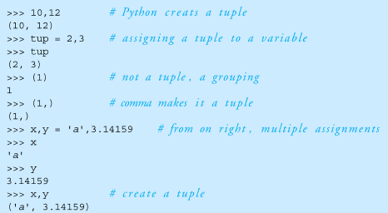
Tuples
Tuples are simple immutable list
They are printed with (,)
Dasar-Dasar Pemrograman Ganjil 2016-2017

Slide 3
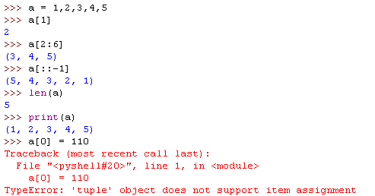
Lists and Tuple
Everything that works with a list works with a tuple except methods that modify the tuple
Thus indexing, slicing, len, print all works as expected
Dasar-Dasar Pemrograman Ganjil 2016-2017

Slide 4
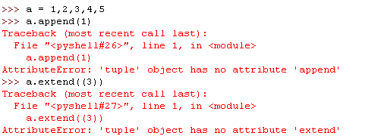
Lists and Tuple (1)
However, none of the mutating methods works on tuples:
  append, extend, del
Dasar-Dasar Pemrograman Ganjil 2016-2017

Slide 5
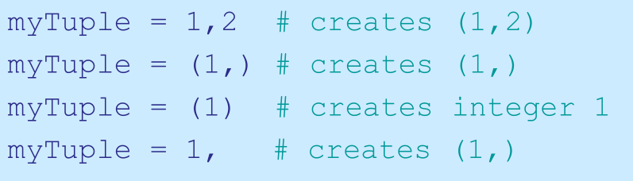
Commas make a tuple
For tuples, you can think of a comma as the operator that makes a tuple where the () simply acts as a grouping:
Dasar-Dasar Pemrograman Ganjil 2016-2017

Slide 6
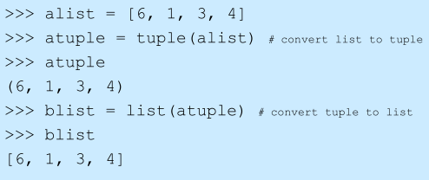
List  Tuple
Dasar-Dasar Pemrograman Ganjil 2016-2017

Slide 7
What is a dictionary?
Dictionary is an associative array, associative list or a map
You can think of it as a list of pairs, where the first element of the pair, the key, is used to retrieve the second element, the value
Thus, we map a key to a value
Dasar-Dasar Pemrograman Ganjil 2016-2017

Slide 8
Key-Value Pairs
The key acts as an index to find the associated value
Just like a dictionary, you look up a word by its spelling to find the associated definition
A dictionary can be searched to locate the value associated with a key
Dasar-Dasar Pemrograman Ganjil 2016-2017

Slide 9


Python Dictionary
Use the { } marker to create a dictionary
Use the : marker to indicate key:value pairs
Output:
Example:
Dasar-Dasar Pemrograman Ganjil 2016-2017

Slide 10
Python Dictionary
Key
Value
“jl. melati”
budi
“jl. mawar”
ani
“jl. anggrek”
toni
Dasar-Dasar Pemrograman Ganjil 2016-2017

Slide 11
Empty Dictionarty
A pair of curly brackets creates an empty dictionary
Alternately, one can use dict function with no argument
Example
  ext_dict = {}
  another_dict = dict()
Dasar-Dasar Pemrograman Ganjil 2016-2017

Slide 12
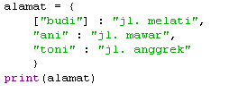

Keys and values
Key must be immutable
  Strings, integers, tuples are fine
  Lists are not
Value can be anything
Output:
Dasar-Dasar Pemrograman Ganjil 2016-2017

Slide 13
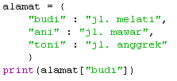
Collections but not a sequence
Dictionaries are collections but they are not sequences such as lists, strings or tuples
  There is no order to the elements of a dictionary
  In fact, the order (for example when printed) might change as elements are added or deleted
How to access dictionary elements?
  Access requires [ ], and the key is the index
Dasar-Dasar Pemrograman Ganjil 2016-2017

Slide 14
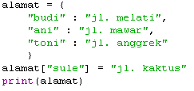
Adding elements to a dictionary
Adding elements to dictionary can simply done by filling the [key] with a value
Output
Dasar-Dasar Pemrograman Ganjil 2016-2017

Slide 15
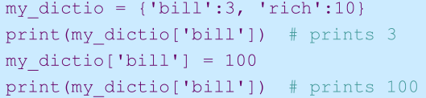
Dictionaries are mutable
Like lists, dictionaries are a mutable data structure
  You can change the object via various operations, such as index assignment
Dasar-Dasar Pemrograman Ganjil 2016-2017

Slide 16
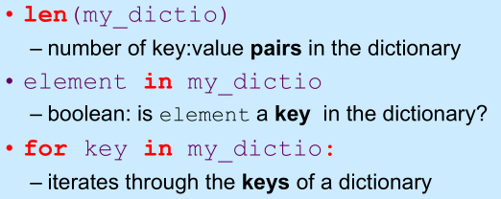
Common operations
Dasar-Dasar Pemrograman Ganjil 2016-2017

Slide 17
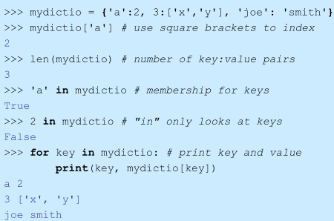
Example
Dasar-Dasar Pemrograman Ganjil 2016-2017

Slide 18
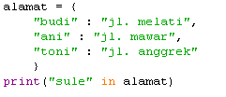

Latihan
Tampilkan output dari kode berikut:
Misal terdapat dictionary nama dan alamat berikut:
Buatlah kode untuk menampilkan nama orang beserta alamatnya!
Dasar-Dasar Pemrograman Ganjil 2016-2017

Slide 19
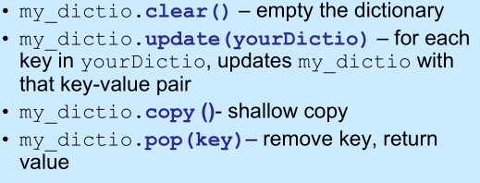
Dictionary methods
Dasar-Dasar Pemrograman Ganjil 2016-2017

Slide 20
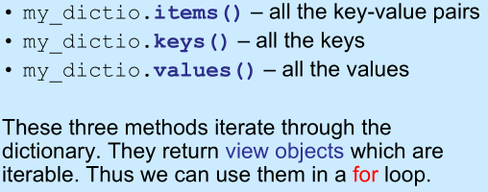
Dictionary content methods
Dasar-Dasar Pemrograman Ganjil 2016-2017

Slide 21
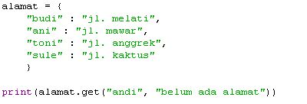
Get method
The get method returns the value associated with a dictionary key or a default value provided as second argument
<dictionary>.get(<key>,<default value>)
Output
Dasar-Dasar Pemrograman Ganjil 2016-2017

Slide 22
Latihan
Buatlah sebuah program sederhana yang menampilkan jumlah huruf dari setiap huruf yang muncul dalam kalimat:
saya suka makan nasi goreng
Contoh output:
{‘s’:2, ‘a’:6, ……….}
Dasar-Dasar Pemrograman Ganjil 2016-2017

Slide 23
References
William Punch & Richard Enbody. The Practice of Computing using Python, 2nd Edition. Addison-Wesley, 2013
Y. Daniel Liang. Introduction to Programming Using Python. Prentice Hall, 2013.
John Zelle. Python Programming: An Introduction to Computer Science, 2nd Edition. Franklin, Beedle & Associates Inc., 2010.
Mark Lutz. Learning Python, 5th Edition. O’Reilly Media. Copyright 2013 Mark Lutz, 978-1-44-93-5573-9
L. Y. Stefanus. Slide Pelatihan Python. 2015.
Dasar-Dasar Pemrograman Ganjil 2016-2017

